Slide 1
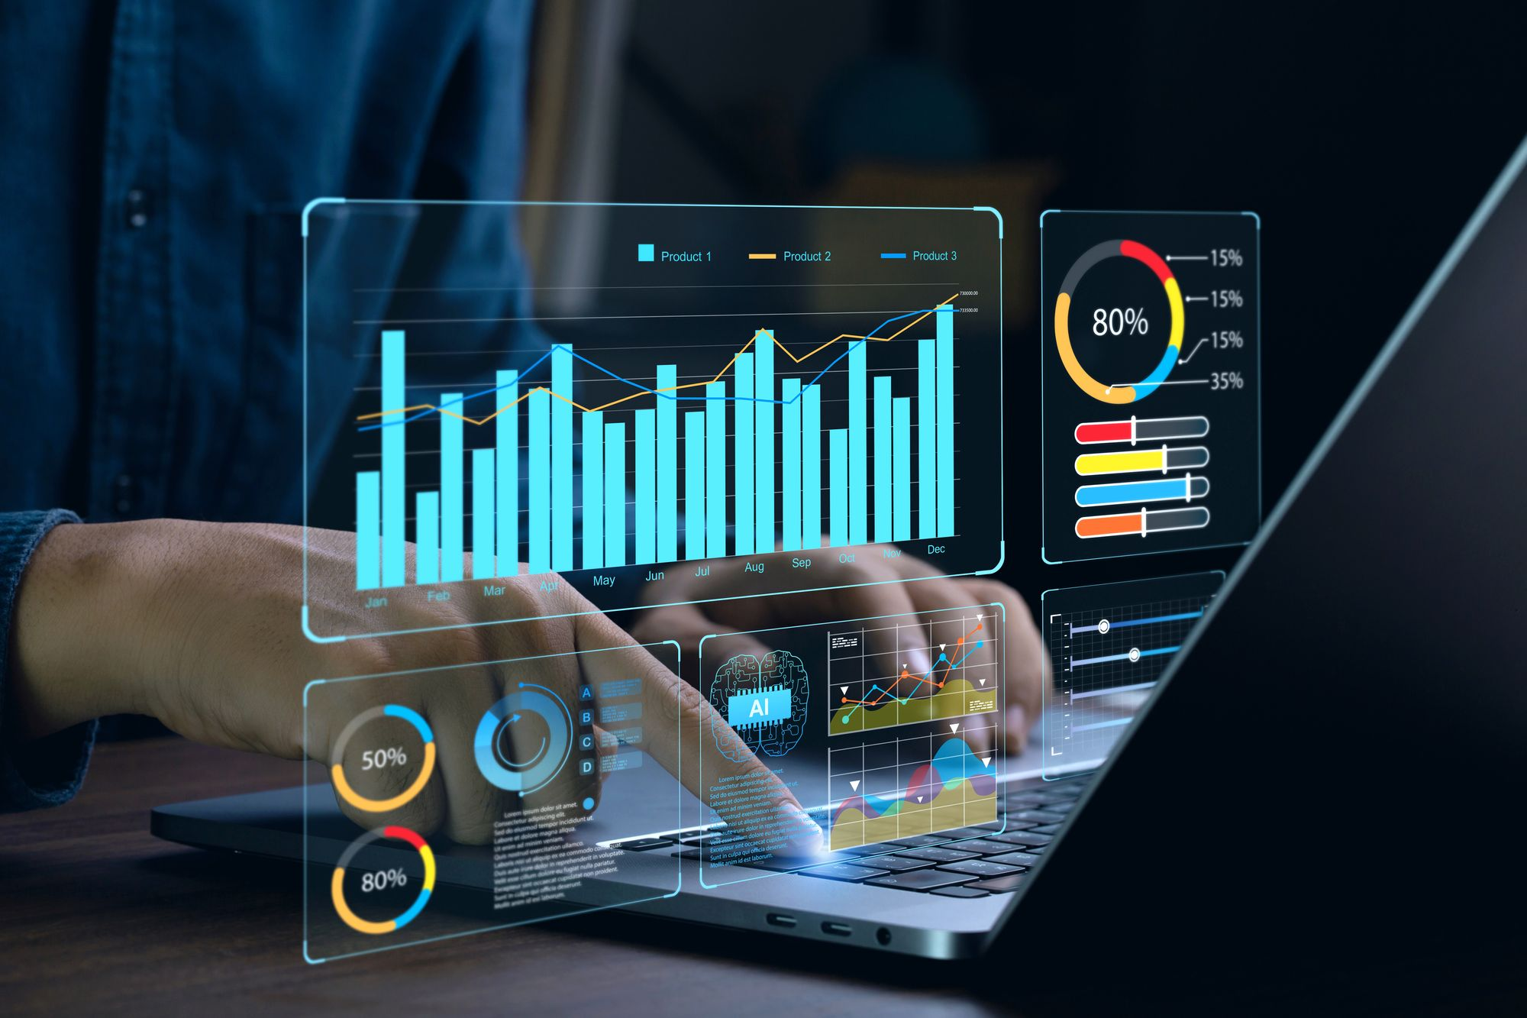
DATA ANALYSIS PORTFOLIO
PREPARED BY:-
SANGRAM KESHARI MOHAPATRA

Slide 2
PROFESSIONAL BACKGROUND
Results-driven Data Analyst with a strong foundation in finance and analytics, backed by an MBA from ICFAI Business School, Kolkata. A former Deputy Manager at ICICI Bank, specializing in wholesale banking for large clients, with 1.5 years of experience in financial analysis and client management. Passionate about data-driven decision-making, with hands-on expertise in SQL Workbench and Microsoft Excel.
Successfully completed 8 data analytics projects, including operational analytics at Microsoft, hiring process data analysis for Trainity, and an IMDB movies analysis. Proficient in data cleaning, exploratory data analysis (EDA), metric investigation, and deriving actionable insights.
In addition to analytics and finance, I am also a digital entrepreneur and network marketer with Forever Living Products, leveraging digital marketing strategies and networking skills to grow businesses online. Experienced in fundraising and volunteering for NGOs, demonstrating strong leadership, communication, and teamwork abilities.

Slide 3
TABLE OF CONTENTS:
PROFESSIONAL BACKGROUND------------------------------------------------------------------------------------------------------------------------------------------------------------------------------------------------------------------------------------------------------------------------------------------------------2
MODULE -1 PROJECT: DATA ANALYSIS STEP IN AUCTION- --------------------------------------------------------------------------------------------------------------------------------------------------------------------------------------------------------------------------------------------------------------------4
DESCRIPTION AND FINDINGS---------------------------------------------------------------------------------------------------------------------------------------------------------------------------------------------------------------------------------------------------------------------------------------------------------5
MODULE-2 PROJECT: INSTAGRAM USER ANALYTICS----------------------------------------------------------------------------------------------------------------------------------------------------------------------------------------------------------------------------------------------------------------------------6
PROJECT DESCRIPTION, CREATING DATABASE------------------------------------------------------------------------------------------------------------------------------------------------------------------------------------------------------------------------------------------------------------------------------------7
FINDINGS----------------------------------------------------------------------------------------------------------------------------------------------------------------------------------------------------------------------------------------------------------------------------------------------------------------------------------8-15
RESULTS AND CONCLUSION-----------------------------------------------------------------------------------------------------------------------------------------------------------------------------------------------------------------------------------------------------------------------------------------------------------16
MODEL 3 PROJECT: OPERATION AND METRIC ANALYSIS------------------------------------------------------------------------------------------------------------------------------------------------------------------------------------------------------------------------------------------------------------------------17
DESCRIPTION, Approach-----------------------------------------------------------------------------------------------------------------------------------------------------------------------------------------------------------------------------------------------------------------------------------------------------------------18
FINDINGS-------------------------------------------------------------------------------------------------------------------------------------------------------------------------------------------------------------------------------------------------------------------------------------------------------------------------------------19-24
MODEL 4 PROJECT: HIRING PROCESS ANALYTICS------------------------------------------------------------------------------------------------------------------------------------------------------------------------------------------------------------------------------------------------------------------------------------25
DESCRIPTION, APPROACH,TECH STACK USED-----------------------------------------------------------------------------------------------------------------------------------------------------------------------------------------------------------------------------------------------------------------------------------------26
FINDINGS-,RESULTS-------------------------------------------------------------------------------------------------------------------------------------------------------------------------------------------------------------------------------------------------------------------------------------------------------------------------27-31
MODEL PROJECT 5: IMDB MOVIE ANALYTICS------------------------------------------------------------------------------------------------------------------------------------------------------------------------------------------------------------------------------------------------------------------------------------------32
DESCRIPTION,APPROACH,TECK STACK USED-------------------------------------------------------------------------------------------------------------------------------------------------------------------------------------------------------------------------------------------------------------------------------------------33
FINDINGS---------------------------------------------------------------------------------------------------------------------------------------------------------------------------------------------------------------------------------------------------------------------------------------------------------------------------------------34-41
MODEL PROJECT 6: BANK LOAN CASE STUDY-------------------------------------------------------------------------------------------------------------------------------------------------------------------------------------------------------------------------------------------------------------------------------------------42
DESCRIPTION,APPROACH,TECK STACK USED--------------------------------------------------------------------------------------------------------------------------------------------------------------------------------------------------------------------------------------------------------------------------------------------43
FINDINGS,RESULTS----------------------------------------------------------------------------------------------------------------------------------------------------------------------------------------------------------------------------------------------------------------------------------------------------------------------------44-53
MODEL PROJECT 7: IMPACT OF CAR FEATURES-----------------------------------------------------------------------------------------------------------------------------------------------------------------------------------------------------------------------------------------------------------------------------------------54
DESCRIPTION,APPROACH,TECK STACK USED----------------------------------------------------------------------------------------------------------------------------------------------------------------------------------------------------------------------------------------------------------------------------------------------55
FINDINGS------------------------------------------------------------------------------------------------------------------------------------------------------------------------------------------------------------------------------------------------------------------------------------------------------------------------------------------66-64
MODEL PROJECT 8: ABC CALL VOLUME TREND ANALYSIS------------------------------------------------------------------------------------------------------------------------------------------------------------------------------------------------------------------------------------------------------------------------------65
DESCRIPTION,APPROACH,TECK STACK USED------------------------------------------------------------------------------------------------------------------------------------------------------------------------------------------------------------------------------------------------------------------------------------------------66
FINDINGS AND RESULTS--------------------------------------------------------------------------------------------------------------------------------------------------------------------------------------------------------------------------------------------------------------------------------------------------------------------------67-73
LEARNINGS--------------------------------------------------------------------------------------------------------------------------------------------------------------------------------------------------------------------------------------------------------------------------------------------------------------------------------------------74
THANK YOU---------------------------------------------------------------------------------------------------------------------------------------------------------------------------------------------------------------------------------------------------------------------------------------------------------------------------------------------75

Slide 4
DATA ANALYSIS STEP IN AUCTION
PROJECT-1

Slide 5
DESCRIPTION:
SELECTING A PLAYER IN AUCTION WE CAN USE DATA ANALYTICS
PROBLEM:
STEPS FOLLOWED IN DATA ANALYTICS
FINDINGS:
STEP-1: PLAN- We First decide which players I have to buy whether it will be a Batsman, Bowler or a wicket keeper
STEP-2: PREPARE- We need to check the amount of purse we have in the bag and the base price of particular players
STEP-3: PROCESS- Here we have to decide if we are going for any particular category of players for an example, we want bowler then we have to look whether we will go for Spin bowler or Fast Bowler then it could be Indian or Foreign players and their availability throughout the season
STEP-4: ANALYZE- Here we will focus on that particular player according to his past 2-3 months performance, then whether he will fit in the team and playing eleven and their availability throughout the season
STEP-5: SHARE- Now we discuss all these things in our think tank and back-end team and find the best for the team
STEP-6: ACT- Finally, we buy him or them

Slide 6
INSTAGRAM USER ANALYTICS
PROJECT 2

Slide 7
Project Description:
Business insights are found that can be used by teams in the business to launch a new marketing campaign, discussing the features to build an application and track
Creating Database:
Values are created and inserted in the database using DDL and DML .
SQL queries provided as per project in MYSQL database using MY SQL workbench

Slide 8
FINDINGS:
MARKETING ANALYSIS:
Rewarding Most Loyal Users: People who have been using the platform for the longest time (TOP 5)

Slide 9
Remind inactive users to start posting: By sending them promotional emails to post their First photo. The users who have never posted a single photo on Instagram

Slide 11
Declaring Context winner:
The team started a contest and the user who gets the most likes on a single photo will win the contest now they wish to declare the winner, Now I have to identify the winner of the contest and provide the details to the team

Slide 12
Hashtag Research: This is to find out which hashtags have to be used to reach the most people on the platform. Now have to identify Top 5 most commonly used hashtags on the platform
The top 5 most commonly used hashtags on the platform

Slide 13
Launch Ad Campaign:
The team wants to know on which day it will be most suitable to launch the Advertisement campaigns. Now to find which day of the week do most users register on to schedule an AD campaign

Slide 14
User Engagement:
This is to know whether the users are still active and post on Instagram or they are making fewer number of posts

Slide 15
Bots and Fake Accounts:
The investor wants to know whether the platform is full with fake and dummy accounts

Slide 16
RESULTS:
This gives the fundamentals of data analysis using SQL Queries to extract insights from the database to track how user engage and interact with our platform so that we give proper and insights to the Product, Marketing and Development team
CONCLUSIONS FROM THE ANALYSIS:
User engagement can be very useful matrix for growth of the company
Marketing team can reward the most loyal customers, send promotional email to the inactive customers, use popular hashtags and find out the best day to do the ad campaign
Company can remove the fake and dummy accounts from the platform to increase user experience

Slide 17
OPERATIONAL AND METRIC ANALYTICS
PROJECT 3

Slide 18
PROJECT DESCRIPTION:
The objective of the project is to analyse the company’s end to end operations which helps identifying the area for improvement. As the Data Analyst of Microsoft, I will work closely with the marketing, operation and support team to derive valuable insights from the collected data source. The project also focuses on investing metric spikes in daily engagement and sales, investing their causes and providing insights to address any dip in these metrices
APPROACH:
Project involves understanding and gathering data sets and tables from various sources and departments within company
Making sure that the given variable and attribute can be understood properly
Importing files into my SQL Workbench and through SQL the collected data will be analysed to give insights and patterns
Key performance metrices are such as daily engagement, sales and customer satisfaction will be identified in collaboration with cross-functional teams
Cross checking the queries one or two times so that the code will run without errors
Once the questions are answered it will be saved with screenshot
Finally, it will be added to the document

Slide 19
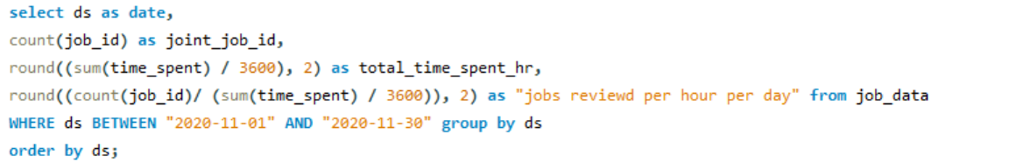
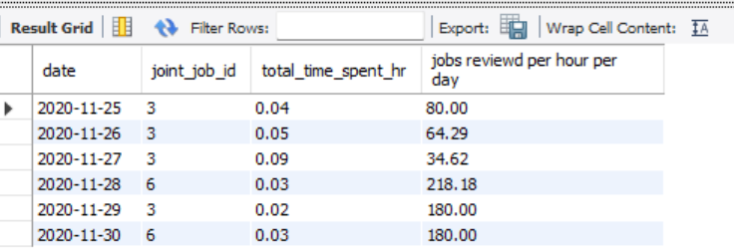
INSIGHTS:
CASE STUDY 1: JOB DATA ANALYSIS
Jobs Reviewed Over Time:
Task: Write an SQL query to calculate the number of jobs reviewed per hour for each day in November 2020.

Slide 20


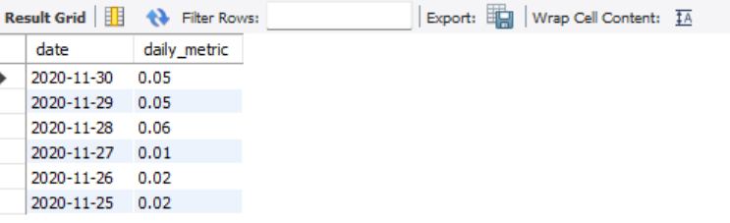
Throughput Analysis:
Task: Write an SQL query to calculate the 7-day rolling average of throughput. Additionally, explain whether you prefer using the daily metric or the 7-day rolling average for throughput, and why.
Weekly Throughput:
Daily Throughput:

Slide 21
LANGUAGE SHARE ANALYSIS:
Task: Write an SQL query to calculate the percentage share of each language over the last 30 days.

Slide 22
INVESTIGATING METRIC SPIKE
WEEKLY USER ENGAGEMENT:
Task: Write an SQL query to calculate the weekly user engagement.

Slide 23
USER GROWTH ANALYSIS:
Task: Write an SQL query to calculate the user growth for the product.

Slide 24
EMAIL ENGAGEMENT ANALYSIS:
Task: Write an SQL query to calculate the email engagement metrics.

Slide 25
HIRING PROCESS ANALYTICS
PROJECT 4

Slide 26
PROJECT DESCRIPTION:
The project was designed to conduct data analytics on the hiring process within a company, with the primary objective of gaining insights into various aspects such as gender distribution, salary analysis, departmental composition, and position tiers. By analyzing these factors with the desired visualization charts the project aimed to provide valuable insights into hiring patterns
APPROACH:
To perform the project a systematic approach was followed. A dataset having relevant information on hires, including gender, salary, department, and position, was obtained. Microsoft Excel 2021 was selected as the primary tool for data analysis due to its versatility and robust capabilities in handling tabular data. Specific techniques such as pivot tables, charts, and formulas were employed to analyze the dataset and extract meaningful insights.
TECH-STACK USED:
Software: Microsoft Excel 2021
Purpose: Excel was chosen for its extensive data analysis functions, including pivot tables, charts, and statistical functions and visualization of the hiring data

Slide 27
TASKS:
Hiring Analysis: The hiring process involves bringing new individuals into the organization for various roles.
Your Task: Determine the gender distribution of hires. How many males and females have been hired by the company?
Count of event_name | event_name
Status | Female | Male | Grand Total
Hired | 1856 | 2563 | 4419
Grand Total | 1856 | 2563 | 4419

Slide 28
B. Salary Analysis:
The average salary is calculated by adding up the salaries of a group of employees and then dividing the total by the number of employees.
Your Task: What is the average salary offered by this company? Use Excel functions to calculate this.
BY PIVOT TABLE
Count of application_id | Average of Offered Salary
7167 | 49899
Status | Average of Offered Salary
Hired | 49625
Grand Total | 49625

Slide 29
C. Salary Distribution:
Class intervals represent ranges of values, in this case, salary ranges. The class interval is the difference between the upper and lower limits of a class.
Your Task: Create class intervals for the salaries in the company. This will help you understand the salary distribution
Column1
Mean | 49899.3
Standard Error | 335.0679
Median | 49625
Mode | 99967
Standard Deviation | 28366.22
Sample Variance | 8.05E+08
Kurtosis | -1.17945
Skewness | 0.013242
Range | 99867
Minimum | 100
Maximum | 99967
Sum | 3.58E+08
Count | 7167
99867 | RANGE
Bin | Frequency
100 | 1
12583 | 851
25067 | 911
37550 | 882
50034 | 967
62517 | 922
75000 | 874
87484 | 920
99967 | 839
More | 0

Slide 30
D. Departmental Analysis:
Visualizing data through charts and plots is a crucial part of data analysis.
Your Task: Use a pie chart, bar graph, or any other suitable visualization to show the proportion of people working in different departments.
Count of Status | Status
Department | Hired | Grand Total
Finance Department | 176 | 176
General Management | 113 | 113
Human Resource Department | 70 | 70
Marketing Department | 202 | 202
Operations Department | 1843 | 1843
Production Department | 246 | 246
Purchase Department | 230 | 230
Sales Department | 485 | 485
Service Department | 1332 | 1332
Grand Total | 4697 | 4697

Slide 31
E. Position Tier Analysis:
Different positions within a company often have different tiers or levels.
Your Task: Use a chart or graph to represent the different position tiers within the company. This will help you understand the distribution of positions across different tiers.
Post Name | Count of Post Name
b9 | 463
c10 | 232
c5 | 1747
c8 | 320
C9 | 1793
i1 | 222
i4 | 88
i5 | 787
i6 | 527
i7 | 981
m6 | 3
m7 | 1
n10 | 1
n6 | 1
n9 | 1
RESULT:
Significant insights into the hiring process analytics and by analyzing hiring patterns, salary distribution, and departmental composition help optimize recruitment strategies and drive organizational growth

Slide 32
IMDB MOVIE ANALYSIS
PROJECT 5

Slide 33
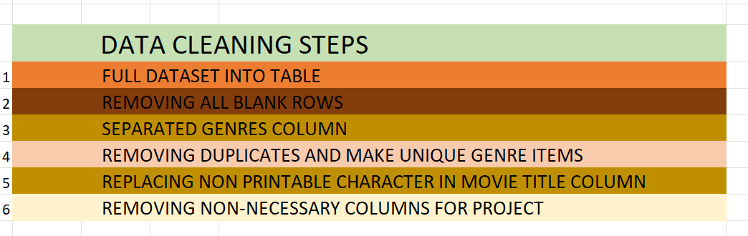
PROJECT DESCRIPTION:
The project was related to IMDB Movies.
The objective of this project is to conduct a comprehensive data analysis of the IMDB Movie datasets. The analysis mainly focuses on several key aspects such as
Movie genres, Duration, Language, Directors and Budget and its impact on IMDB scores and financial success of the movies.
APPROACH:
DATA CLEANING:

Slide 34
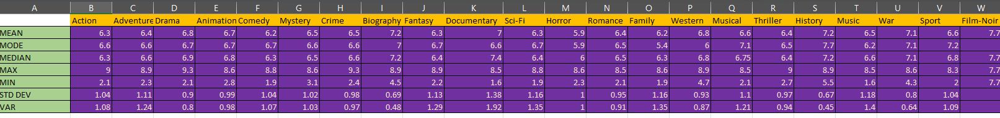
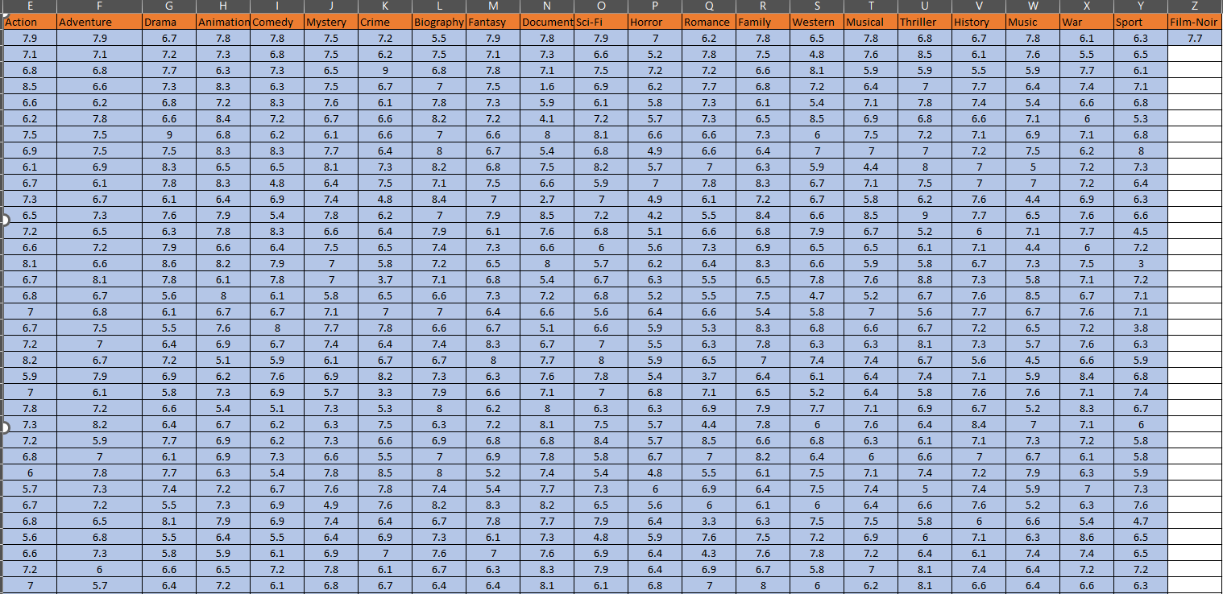
Movie Genre Analysis: Analyse the distribution of movie genres and their impact on the IMDB score.
Task: Determine the most common genres of movies in the dataset. Then, for each genre, calculate descriptive statistics (mean, median, mode, range, variance, standard deviation) of the IMDB scores.

Slide 35
B. Movie Duration Analysis:
Analyse the distribution of movie durations and its impact on the IMDB score.
Task: :
Analyse the distribution of movie durations and identify the relationship between movie duration and IMDB score.
MOVIE DURATION
MEAN | 110.26
MEDIA | 106.00
STD | 22.65

Slide 36
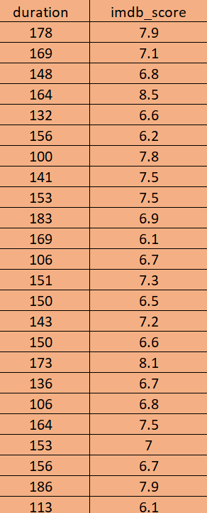

Slide 37
C. Language Analysis: Situation: Examine the distribution of movies based on their language.
Task: Determine the most common languages used in movies and analyse their impact on the IMDB score using descriptive statistics.
Language | Average of imdb_score
Aboriginal | 7.0
Arabic | 7.2
Aramaic | 7.1
Bosnian | 4.3
Cantonese | 7.3
Czech | 7.4
Danish | 7.9
Dari | 7.5
Dutch | 7.6
English | 6.4
Filipino | 6.7
French | 7.4
German | 7.8
Hebrew | 8.0
Hindi | 7.2
Hungarian | 7.1
Indonesian | 7.9
Italian | 7.2
Japanese | 7.7
Kazakh | 6.0
Korean | 7.7
Mandarin | 7.1
Maya | 7.8
Mongolian | 7.3
None | 8.5
Norwegian | 7.2
Persian | 8.1
Portuguese | 7.8
Romanian | 7.9
Russian | 6.5
Spanish | 7.1
Thai | 6.6
Vietnamese | 7.4
Zulu | 7.3

Slide 38
Top 5 most common languages
Language | No of Movies
English | 3598
French | 34
Spanish | 23
Mandarin | 15
Japanese | 10

Slide 39
D. Director Analysis: Influence of directors on movie ratings.
Task: Identify the top directors based on their average IMDB score and analyse their contribution to the success of movies using percentile calculations.
director_name | Average of imdb_score | percentaile
Akira Kurosawa | 8.7 | 99.40%
Tony Kaye | 8.6 | 99.20%
Charles Chaplin | 8.6 | 99.20%
Ron Fricke | 8.5 | 98.70%
Majid Majidi | 8.5 | 98.70%
Damien Chazelle | 8.5 | 98.70%
Alfred Hitchcock | 8.5 | 98.70%
Sergio Leone | 8.4 | 98.70%
Christopher Nolan | 8.4 | 98.70%
Richard Marquand | 8.4 | 98.30%

Slide 41
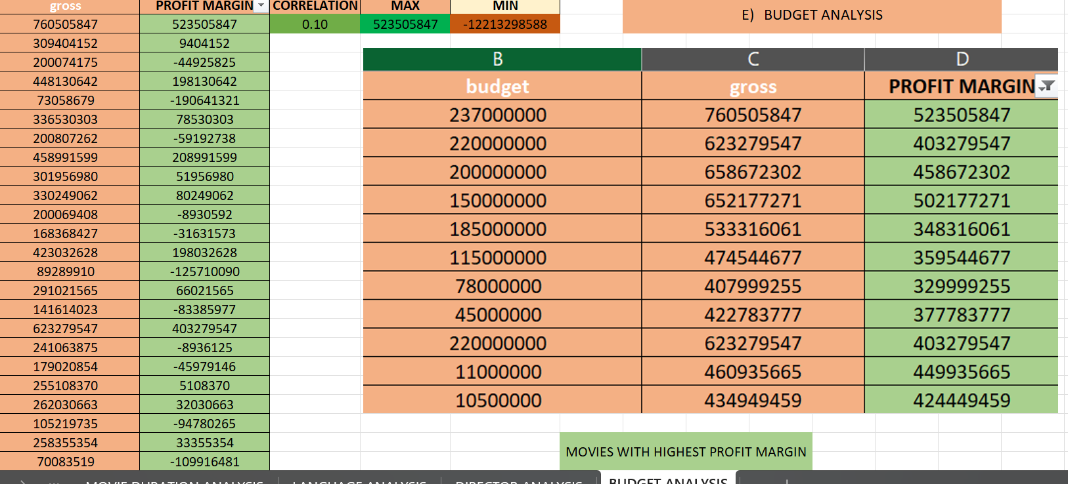
E. Budget Analysis: Explore the relationship between movie budgets and their financial success.
Task: Analyse the correlation between movie budgets and gross earnings, and identify the movies with the highest profit margin.

Slide 42
BANK LOAN CASE-STUDY
PROJECT 6

Slide 43
PROJECT DESCRIPTION:
The case study aims to identify a pattern if a client has difficulty paying their installment. This project also provides an example of how EDA (EXPLORATORY DATA ANALYSIS) might be used in the real-world corporate setting. Some learning about risk analytics in banking. The goal is to detect what are the trends that show whether a client has trouble paying their installments. The process starts from data cleaning to the basic method of data analysis such as univariate, segment univariate and bivariate analysis and correlation between variables
APPROACH:
To perform the project a systematic approach was followed. A dataset was downloaded. Microsoft Excel 2021 was selected as the primary tool for data analysis such as cleaning, missing data and other EDAs as needed due to its versatility and robust capabilities in handling tabular data. Specific techniques such as pivot tables, charts, and formulas were employed to analyze the dataset and extract meaningful insights.
TECH-STACK USED:
Software: Microsoft Excel 2021
Purpose: Excel was chosen for its extensive data analysis functions, including pivot tables, charts, and statistical functions and visualization of the hiring data

Slide 44
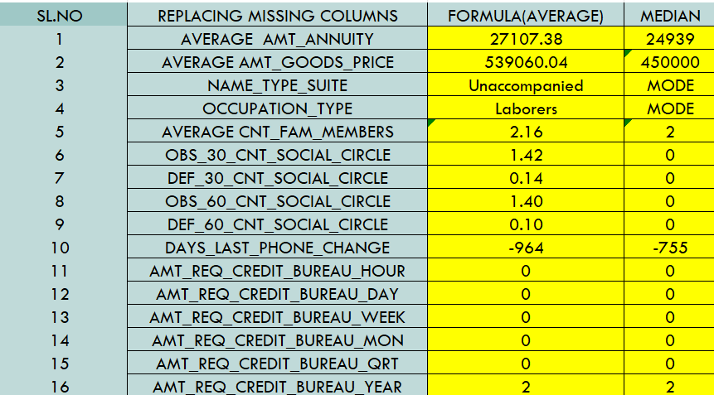
A. IDENTIFY MISSING DATA AND DEAL WITH IT APPROPRIATELY:
As a data analyst, you come across missing data in the loan application dataset. It is essential to handle missing data effectively to ensure the accuracy of the analysis.
Task:
Identify the missing data in the dataset and decide on an appropriate method to deal with it using Excel built-in functions and features.

Slide 45
B. Identify Outliers in the Dataset:
Outliers can significantly impact the analysis and distort the results. You need to identify outliers in the loan application dataset
.
Task: Detect and identify outliers in the dataset using Excel statistical functions and features, focusing on numerical variables.
Q1 | 112500
Q3 | 202500
IQR(Q3-Q1) | 90000
MIN | -22500
MAX | 225000
MEDIAN | 145800

Slide 46
Q1 | 270000
Q3 | 808650
IQR(Q3-Q1) | 538650
MIN | -537975
MAX | 1616625
MEDIAN | 514777.5

Slide 47
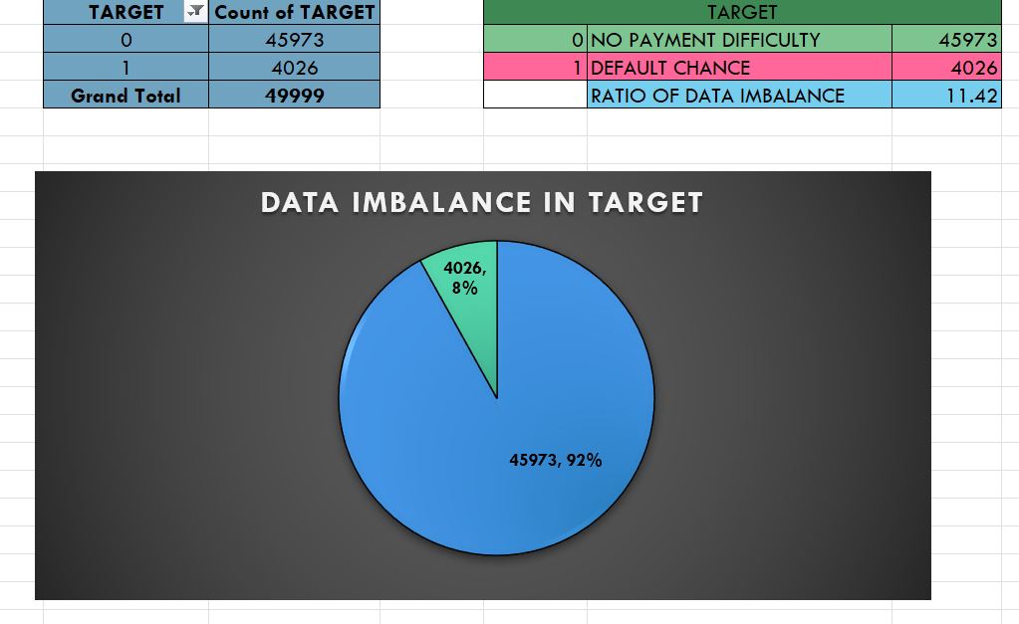
C. Analyse Data Imbalance: Data imbalance can affect the accuracy of the analysis, especially for binary classification problems. Understanding the data distribution is crucial for building reliable models.
Task: Determine if there is data imbalance in the loan application dataset and calculate the ratio of data imbalance using Excel functions.

Slide 48
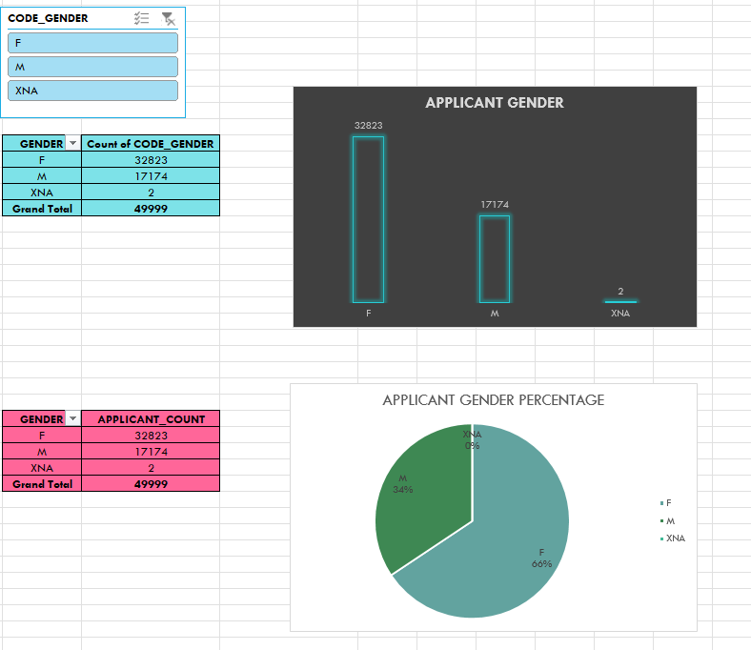
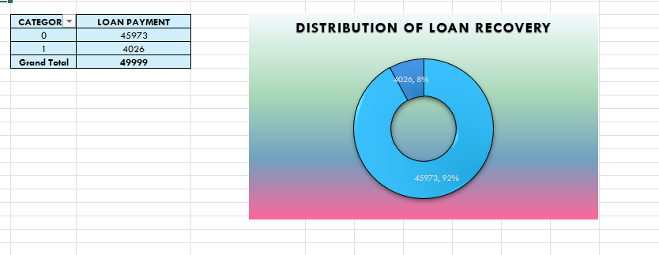
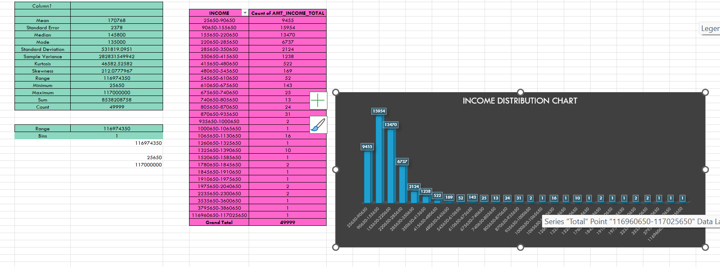
D. Perform Univariate, Segmented Univariate, and Bivariate Analysis: To gain insights into the driving factors of loan default, it is important to conduct various analyses on consumer and loan attributes.
Task: Perform univariate analysis to understand the distribution of individual variables, segmented univariate analysis to compare variable distributions for different scenarios, and bivariate analysis to explore relationships between variables and the target variable using Excel functions and features.

Slide 49
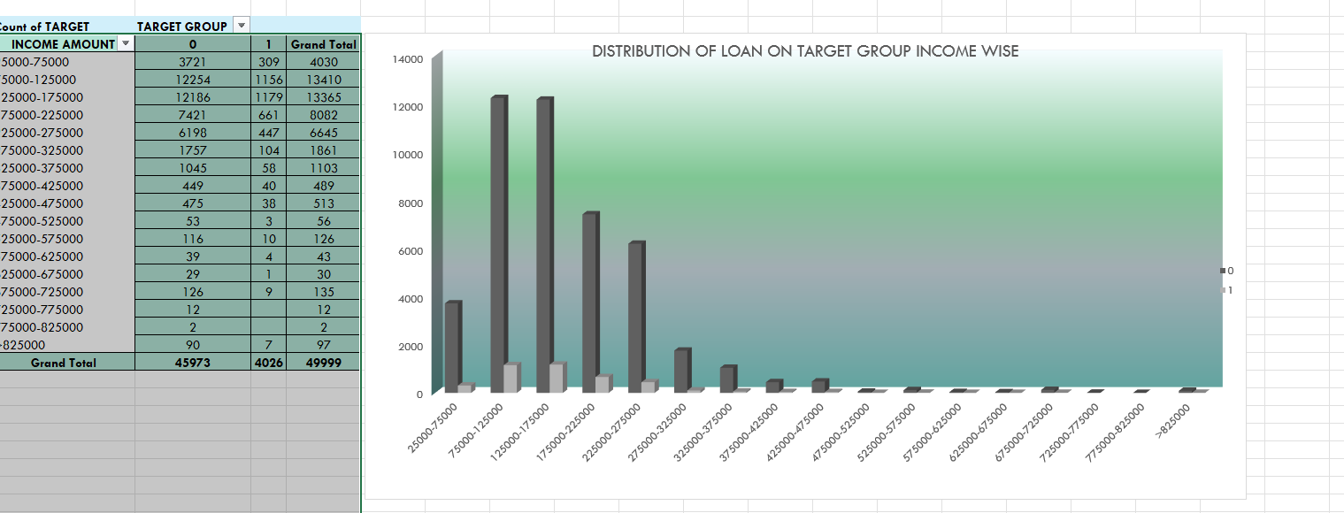
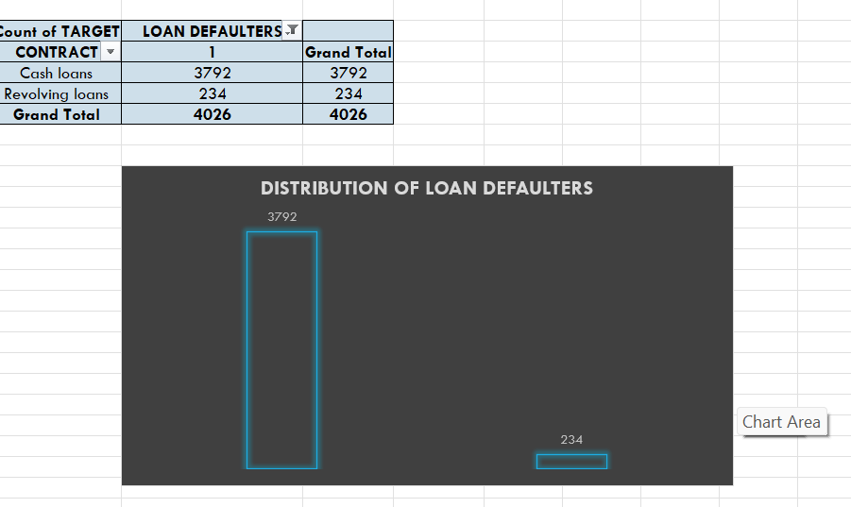
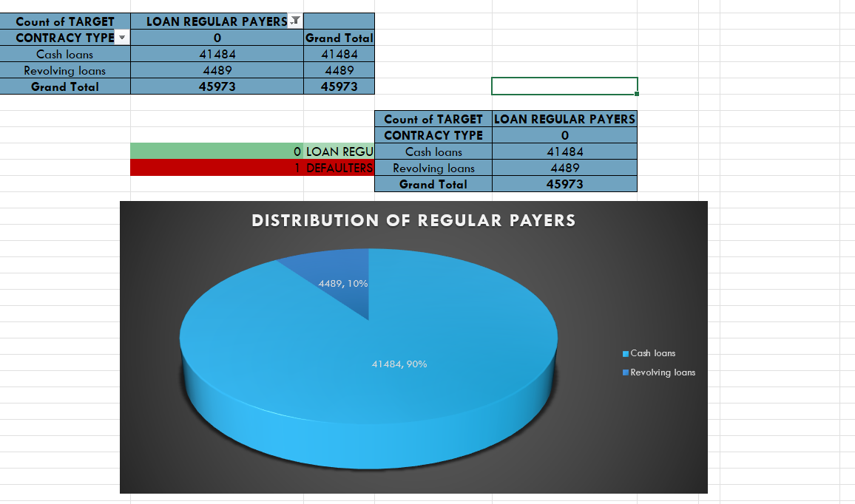
SEGMENT UNIVARIATE ANALYSIS:

Slide 50
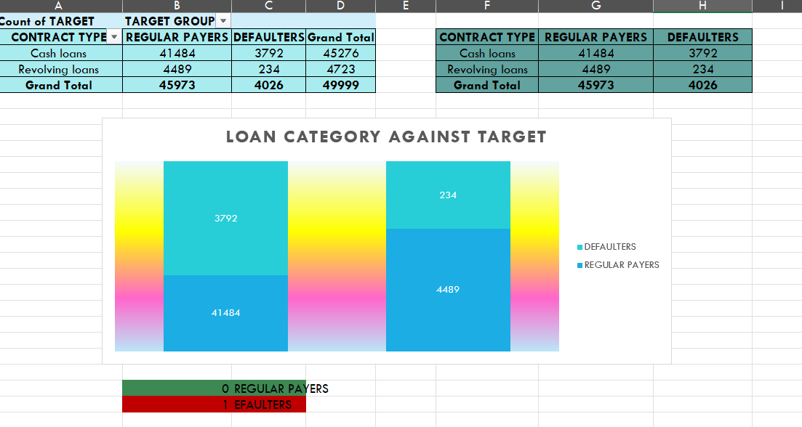
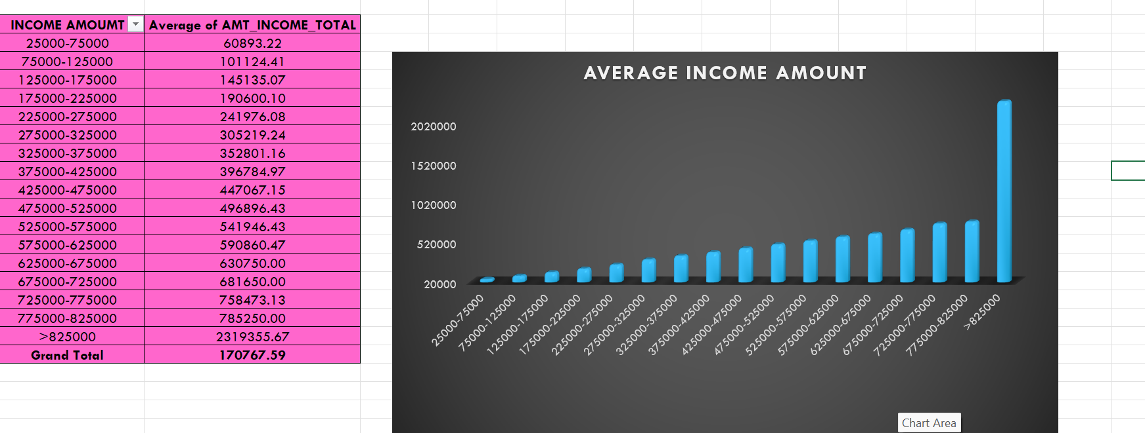
BIVARIATE ANALYSIS:

Slide 51
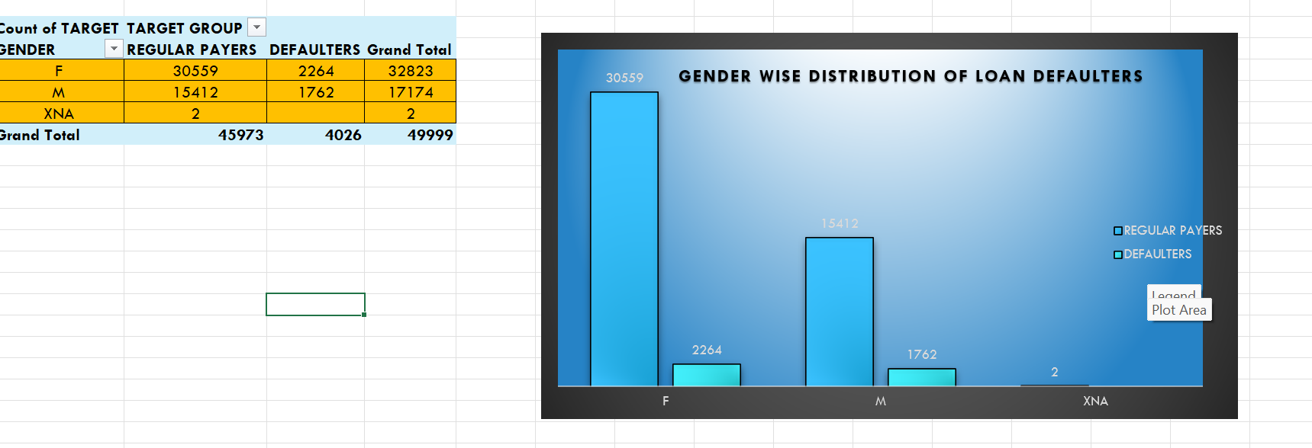
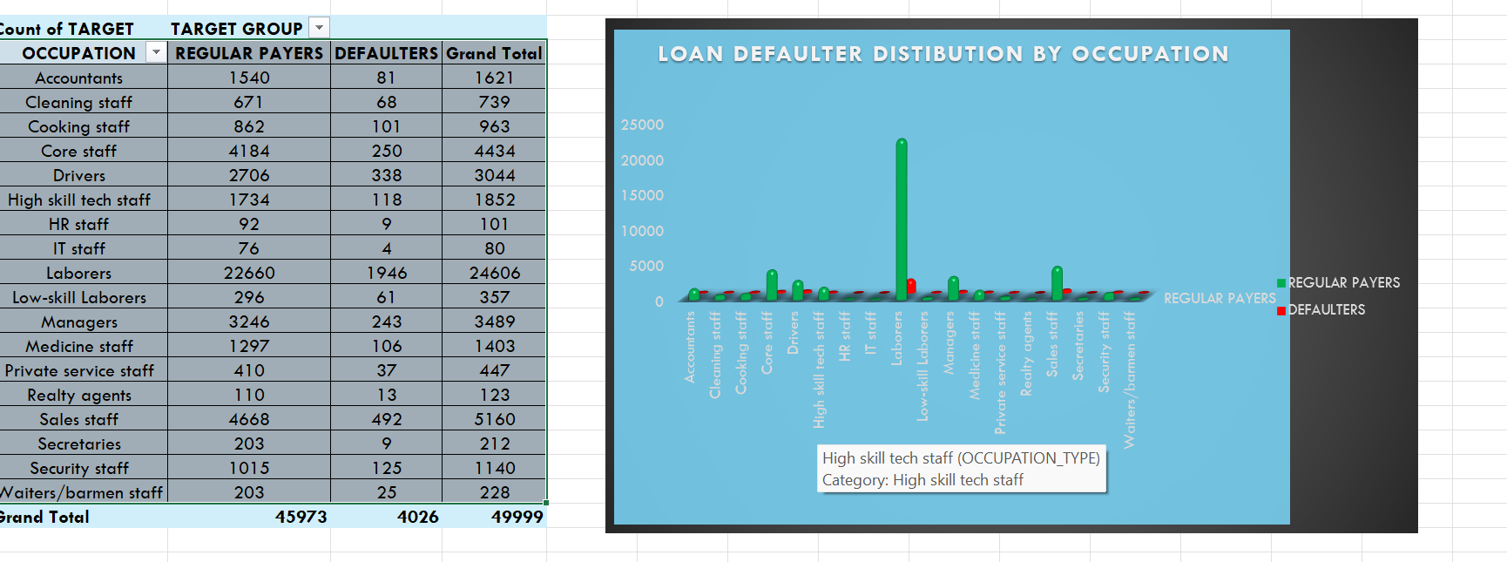

Slide 52
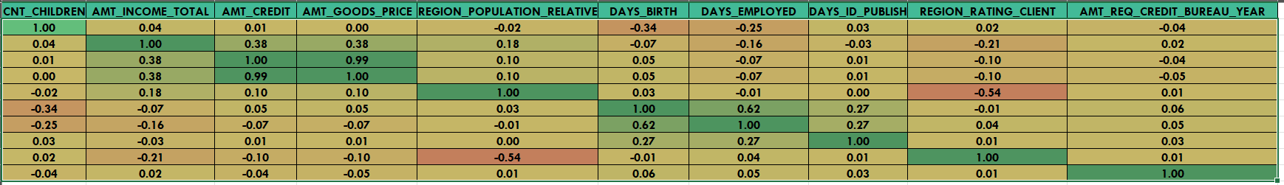
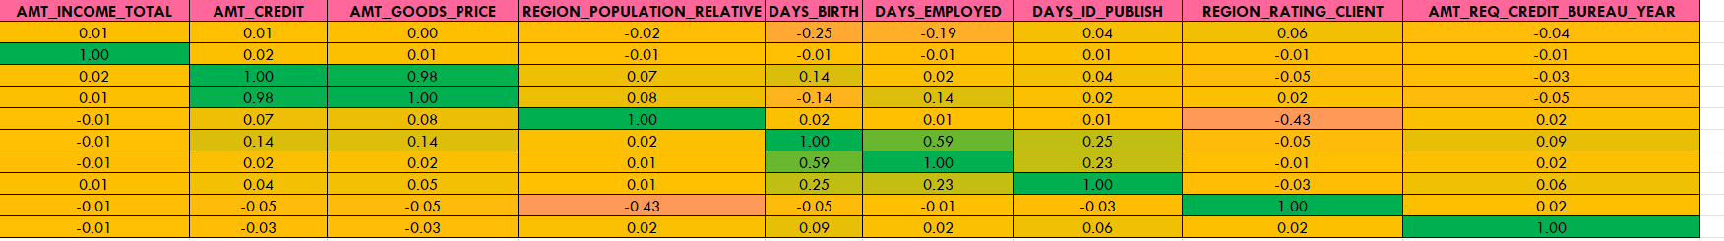
E. Identify Top Correlations for Different Scenarios: Understanding the correlation between variables and the target variable can provide insights into strong indicators of loan default.
Task: Segment the dataset based on different scenarios (e.g., clients with payment difficulties and all other cases) and identify the top correlations for each segmented data using Excel functions.
TARGET (0):
TARGET (0):

Slide 53
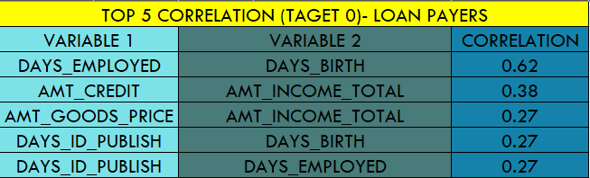
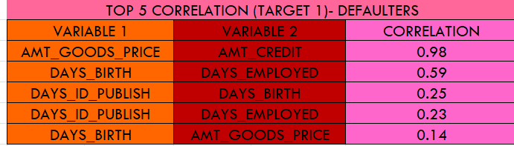
RESULTS: The Bank Lona case study was executed starting with data cleaning process as missing data, identifying outliers and other exploratory data analysis then followed by different analysis and then identify the correlation between different variables

Slide 54
IMPACT OF CAR FEATURES
PROJECT 7

Slide 55
PROJECT DESCRIPTION:
For the given dataset, as a Data Analyst, the client has asked How can a car manufacturer optimize pricing and product development decisions to maximize profitability while meeting consumer demand?
This problem could be approached by analysing the relationship between a car's features, market category, and pricing, and identifying which features and categories are most popular among consumers and most profitable for the manufacturer.
By using data analysis techniques such as regression analysis and market segmentation, the manufacturer could develop a pricing strategy that balances consumer demand with profitability, and identify which product features to focus on in future product development efforts
APPROACH:
To perform the project a systematic approach was followed. A dataset was downloaded. Microsoft Excel 2021 was selected as the primary tool for data analysis such as cleaning, deleting blank rows and due to its versatility and robust capabilities in handling tabular data. Specific techniques such as pivot tables, charts, visualizations and were employed to analyze the dataset and extract meaningful insights.
TECH-STACK USED:
Software: Microsoft Excel 2021
Purpose: Excel was chosen for its extensive data analysis functions, including pivot tables, charts, and statistical functions and visualization of the Car data

Slide 56
TASK ANALYSIS:
Insight Required: How does the popularity of a car model vary across different market categories?
Task 1.A: Create a pivot table that shows the number of car models in each market category and their corresponding popularity scores.
Task 1.B: Create a combo chart that visualizes the relationship between market category and popularity.
MARKET CATEGORY | Average of Popularity | Count of Model
Crossover | 1529.03 | 1103
Crossover,Diesel | 873.00 | 7
Crossover,Exotic,Luxury,High-Performance | 238.00 | 1
Crossover,Exotic,Luxury,Performance | 238.00 | 1
Crossover,Factory Tuner,Luxury,High-Performance | 1823.46 | 26
Crossover,Factory Tuner,Luxury,Performance | 2607.40 | 5
Crossover,Factory Tuner,Performance | 210.00 | 4
Crossover,Flex Fuel | 2073.75 | 64
Crossover,Flex Fuel,Luxury | 1173.20 | 10
Crossover,Flex Fuel,Luxury,Performance | 1624.00 | 6
Crossover,Flex Fuel,Performance | 5657.00 | 6
Crossover,Hatchback | 1675.69 | 72
Crossover,Hatchback,Factory Tuner,Performance | 2009.00 | 6
Crossover,Hatchback,Luxury | 204.00 | 7
Crossover,Hatchback,Performance | 2009.00 | 6
Crossover,Hybrid | 2563.38 | 42
Crossover,Luxury | 884.55 | 410
Crossover,Luxury,Diesel | 2195.85 | 33
Crossover,Luxury,High-Performance | 1037.22 | 9
Crossover,Luxury,Hybrid | 630.92 | 24
Crossover,Luxury,Performance | 1344.85 | 113
Crossover,Luxury,Performance,Hybrid | 3916.00 | 2
Crossover,Performance | 2585.96 | 69
Diesel | 1730.90 | 84
Diesel,Luxury | 2275.00 | 51
Exotic,Factory Tuner,High-Performance | 1046.38 | 21
Exotic,Factory Tuner,Luxury,High-Performance | 517.54 | 52
Exotic,Factory Tuner,Luxury,Performance | 520.00 | 3
Exotic,Flex Fuel,Factory Tuner,Luxury,High-Performance | 520.00 | 13
Exotic,Flex Fuel,Luxury,High-Performance | 520.00 | 11
Exotic,High-Performance | 1261.57 | 252
Exotic,Luxury | 112.67 | 12
Exotic,Luxury,High-Performance | 467.08 | 79
Exotic,Luxury,High-Performance,Hybrid | 204.00 | 1
Exotic,Luxury,Performance | 217.03 | 36
Factory Tuner,High-Performance | 1941.42 | 106
Factory Tuner,Luxury | 617.00 | 2
Factory Tuner,Luxury,High-Performance | 2133.37 | 215
Factory Tuner,Luxury,Performance | 1413.42 | 31
Factory Tuner,Performance | 1733.10 | 89
Flex Fuel | 2217.30 | 872
Flex Fuel,Diesel | 5657.00 | 16
Flex Fuel,Factory Tuner,Luxury,High-Performance | 258.00 | 1
Flex Fuel,Hybrid | 155.00 | 2
Flex Fuel,Luxury | 746.54 | 39
Flex Fuel,Luxury,High-Performance | 878.91 | 33
Flex Fuel,Luxury,Performance | 1380.07 | 28
Flex Fuel,Performance | 1702.36 | 81
Flex Fuel,Performance,Hybrid | 155.00 | 2
Hatchback | 1293.00 | 614
Hatchback,Diesel | 873.00 | 14
Hatchback,Factory Tuner,High-Performance | 1205.15 | 13
Hatchback,Factory Tuner,Luxury,Performance | 886.89 | 9
Hatchback,Factory Tuner,Performance | 2159.05 | 22
Hatchback,Flex Fuel | 5657.00 | 7
Hatchback,Hybrid | 2121.25 | 72
Hatchback,Luxury | 1379.50 | 46
Hatchback,Luxury,Hybrid | 454.00 | 3
Hatchback,Luxury,Performance | 1566.13 | 38
Hatchback,Performance | 1039.65 | 252
High-Performance | 1821.45 | 199
Hybrid | 2105.57 | 123
Luxury | 1107.55 | 851
Luxury,High-Performance | 1668.02 | 334
Luxury,High-Performance,Hybrid | 568.83 | 12
Luxury,Hybrid | 724.69 | 48
Luxury,Performance | 1292.62 | 673
Luxury,Performance,Hybrid | 2333.18 | 11
Performance | 1371.08 | 584
Performance,Hybrid | 155.00 | 1
Grand Total | 1499.397823 | 8084

Slide 57
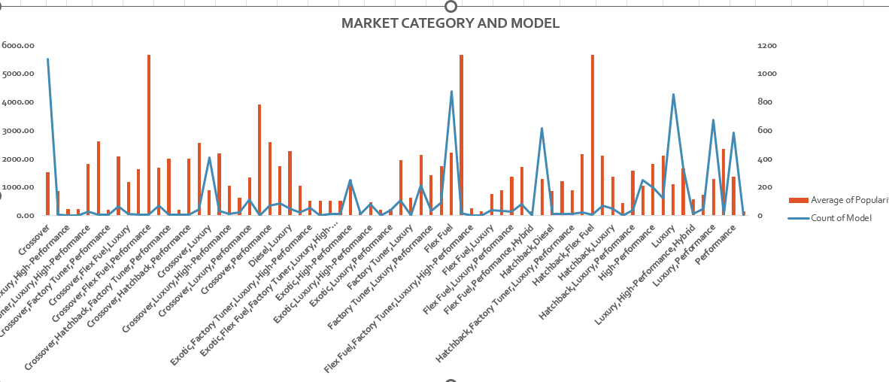

Slide 58
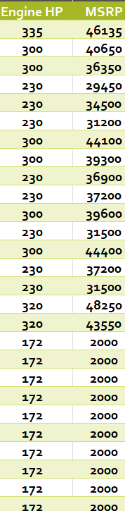
Insight Required: What is the relationship between a car's engine power and its price?
Task 2: Create a scatter chart that plots engine power on the x-axis and price on the y-axis. Add a trendline to the chart to visualize the relationship between these variables.

Slide 59
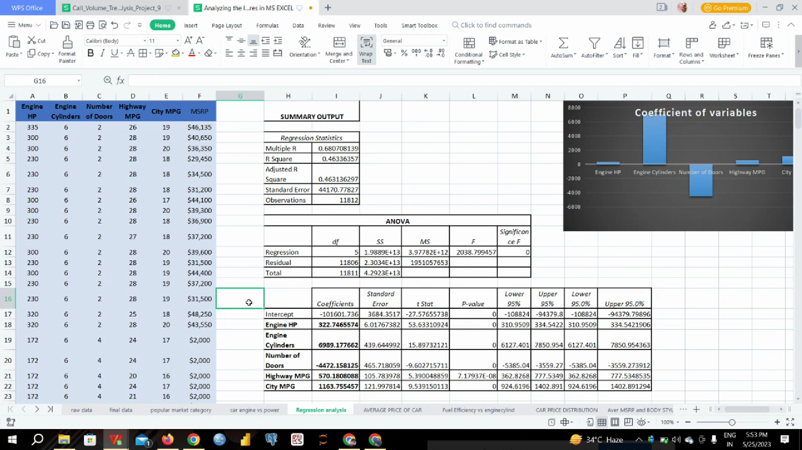
Insight Required: Which car features are most important in determining a car's price?
Task 3: Use regression analysis to identify the variables that have the strongest relationship with a car's price. Then create a bar chart that shows the coefficient values for each variable to visualize their relative importance.

Slide 60
Insight Required: How does the average price of a car vary across different manufacturers?
Task 4.A: Create a pivot table that shows the average price of cars for each manufacturer.
Task 4.B: Create a bar chart or a horizontal stacked bar chart that visualizes the relationship between manufacturer and average price.
Row Labels | Average of MSRP
Acura | 34887.59
Alfa Romeo | 61600.00
Aston Martin | 197910.38
Audi | 53452.11
Bentley | 247169.32
BMW | 61546.76
Bugatti | 1757223.67
Buick | 28206.61
Cadillac | 56231.32
Chevrolet | 28273.36
Chrysler | 26722.96
Dodge | 22390.06
Ferrari | 237383.82
FIAT | 22206.02
Ford | 27393.42
Genesis | 46616.67
GMC | 30493.30
Honda | 26629.82
HUMMER | 36464.41
Hyundai | 24597.04
Infiniti | 42394.21
Kia | 25112.39
Lamborghini | 331567.31
Land Rover | 67823.22
Lexus | 47549.07
Lincoln | 42494.37
Lotus | 69188.28
Maserati | 114207.71
Maybach | 546221.88
Mazda | 19719.06
McLaren | 239805.00
Mercedes-Benz | 71537.81
Mitsubishi | 21215.47
Nissan | 28513.37
Oldsmobile | 11542.54
Plymouth | 3122.90
Pontiac | 19321.55
Porsche | 101622.40
Rolls-Royce | 351130.65
Saab | 27413.50
Scion | 19932.50
Spyker | 213323.33
Subaru | 24827.50
Suzuki | 17900.96
Toyota | 28946.15
Volkswagen | 28076.20
Volvo | 28541.16
Grand Total | 40559.94

Slide 62
Insight Required: What is the relationship between fuel efficiency and the number of cylinders in a car's engine?
Task 5.A: Create a scatter plot with the number of cylinders on the x-axis and highway MPG on the y-axis. Then create a trendline on the scatter plot to visually estimate the slope of the relationship and assess its significance.
Task 5.B: Calculate the correlation coefficient between the number of cylinders and highway MPG to quantify the strength and direction of the relationship.
Engine Cylinders | highway MPG
6 | 26
6 | 28
6 | 28
6 | 28
6 | 28
6 | 28
6 | 26
6 | 28
6 | 28
6 | 27
6 | 28
6 | 28
6 | 28
6 | 28
6 | 28
6 | 25
6 | 28
6 | 24
6 | 24
6 | 20
6 | 24
6 | 21
6 | 24
6 | 20
CORRELATION COEFFICIENT
-0.62 | SHOWING NEGATIVE CORRELATION

Slide 64
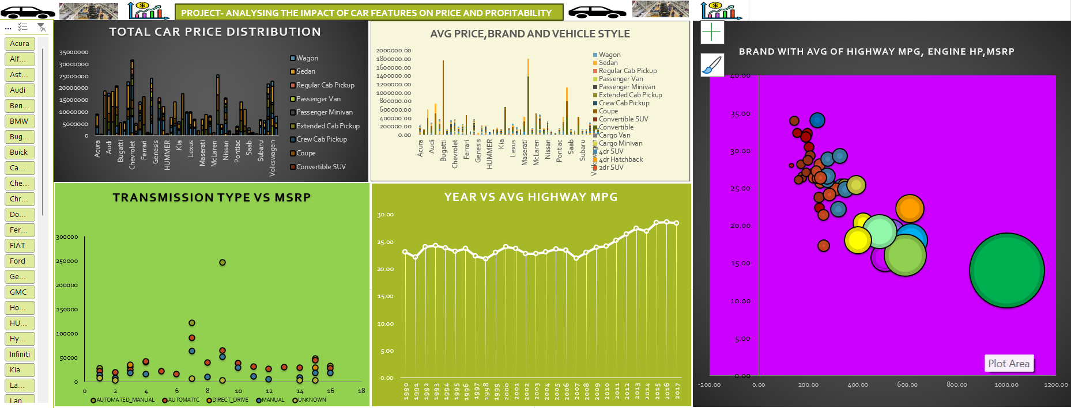
BUILDING DASHBOARD

Slide 65
ABC CALL VOLUME TREND ANALYSIS
PROJECT 8

Slide 66
PROJECT DESCRIPTION:
In this project, we will move into the world of Customer Experience (CX) analytics, specifically focusing on the inbound calling team of a company. A dataset that spans 23 days and includes various details such as the agent's name and ID, the queue time (how long a customer had to wait before connecting with an agent), the time of the call, the duration of the call, and the call status (whether it was abandoned, answered, or transferred) is provided to us. The goal is to attract, engage, and delight customers, turning them into loyal advocates for the business.
APPROACH:
To perform the project a systematic approach was followed. A dataset having relevant information on agent's name and ID, the queue time, the time of the call, the duration of the call, and the call status was downloaded. Microsoft Excel 2021 was selected as the primary tool for data analysis due to its versatility and robust capabilities in handling tabular data. There are N/A in the dataset but as per the tasks those data columns are not required so they remain there in the dataset which will not affect our analysis.
TECH-STACK USED:
Software: Microsoft Excel 2021
Purpose: Excel was chosen for its extensive data analysis functions, including pivot tables, charts, and statistical functions and visualization of the call data

Slide 67
AVERAGE CALL DURATION:
Your Task: What is the average duration of calls for each time bucket?
Call_Status | answered
Time Bucket | Average of Call_Seconds (s)
10_11 | 203.33
11_12 | 199.26
12_13 | 192.89
13_14 | 194.74
14_15 | 193.68
15_16 | 198.89
16_17 | 200.87
17_18 | 200.25
18_19 | 202.55
19_20 | 203.41
20_21 | 202.85
9_10 | 199.07
Grand Total | 198.62
As seen in the graph we can clearly the average duration of calls for each time buckets for answered calls only. For 7pm-8pm the duration of calls is the highest and for 12 pm -1 pm the value is the lowest amongst all

Slide 68
CALL VOLUME ANALYSIS:
Your Task: Can you create a chart or graph Highest no of calls received during between 11 am to 12 pm as clearly seen in this graph
that shows the number of calls received in each time bucket?
Time Bucket | Count of Customer_Phone_No | Count of Call_Seconds (s)
10_11 | 13313 | 11.28%
11_12 | 14626 | 12.40%
12_13 | 12652 | 10.72%
13_14 | 11561 | 9.80%
14_15 | 10561 | 8.95%
15_16 | 9159 | 7.76%
16_17 | 8788 | 7.45%
17_18 | 8534 | 7.23%
18_19 | 7238 | 6.13%
19_20 | 6463 | 5.48%
20_21 | 5505 | 4.67%
9_10 | 9588 | 8.13%
Grand Total | 117988 | 100.00%
Highest no of calls received during between 11 am to 12 pm as clearly seen in this graph

Slide 69
MANPOWER PLANNING:
Your Task: What is the minimum number of agents required in each time bucket to reduce the abandon rate to 10%?
Row Labels | Average of Call_Seconds (s) | Count of Customer_Phone_No | Count of Customer_Phone_No2
abandon | 0.00 | 34403 | 29%
answered | 198.62 | 82452 | 70%
transfer | 76.15 | 1133 | 1%
Grand Total | 139.53 | 117988 | 100.00%

Slide 70
The current rate of abandoned calls is approximately 30%.
Propose a plan for manpower allocation during each time bucket (from 9 am to 9 pm) to reduce the abandon rate to 10%.
In other words, you need to calculate the minimum number of agents required in each time bucket to ensure that at least 90 out of 100 calls are answered.
Time Bucket | Count of Call_Seconds (s) | Count of Call_Seconds (s)2 | call_seconds | Agent Required
10_11 | 11.28% | 0.11 | 0.11 | 6
11_12 | 12.40% | 0.12 | 0.12 | 7
12_13 | 10.72% | 0.11 | 0.11 | 6
13_14 | 9.80% | 0.10 | 0.10 | 6
14_15 | 8.95% | 0.09 | 0.09 | 5
15_16 | 7.76% | 0.08 | 0.08 | 4
16_17 | 7.45% | 0.07 | 0.07 | 4
17_18 | 7.23% | 0.07 | 0.07 | 4
18_19 | 6.13% | 0.06 | 0.06 | 3
19_20 | 5.48% | 0.05 | 0.05 | 3
20_21 | 4.67% | 0.05 | 0.05 | 3
9_10 | 8.13% | 0.08 | 0.08 | 5
Grand Total | 100.00% | 1.00 | 1.00 | 57

Slide 71
Date_&_Time2 | 01-Jan
Row Labels | Sum of Call_Seconds (s)
09 | 35313.00 |  | 188.0 | Per one day
10 | 53087.00 |  | 38 | As mentioned, 60%
11 | 67751.00 | So | 60% | 38
12 | 72680.00 |  | 90% | 57 | Total agent req
13 | 59693.00
14 | 76137.00
15 | 65689.00
16 | 59464.00
17 | 68155.00
18 | 53096.00
19 | 40141.00
20 | 25281.00
21 | 177.00
Grand Total | 676664.00
Total agent required are 57 and the minimum number of agents required in each time bucket to ensure that at least 90 out of 100 calls are answered are also shown by the table

Slide 72
NIGHT SHIFT MANPOWER PLANNING:
Your Task: Propose a manpower plan for each time bucket throughout the day, keeping the maximum abandon rate at 10%.
Count of Call_Status | Column Labels
Row Labels | abandon | answered | transfer | Grand Total
01-Jan | 684 | 3883 | 77 | 4644
02-Jan | 356 | 2935 | 60 | 3351
03-Jan | 599 | 4079 | 111 | 4789
04-Jan | 595 | 4404 | 114 | 5113
05-Jan | 536 | 4140 | 114 | 4790
06-Jan | 991 | 3875 | 85 | 4951
07-Jan | 1319 | 3587 | 42 | 4948
08-Jan | 1103 | 3519 | 50 | 4672
09-Jan | 962 | 2628 | 62 | 3652
10-Jan | 1212 | 3699 | 72 | 4983
11-Jan | 856 | 3695 | 86 | 4637
12-Jan | 1299 | 3297 | 47 | 4643
13-Jan | 738 | 3326 | 59 | 4123
14-Jan | 291 | 2832 | 32 | 3155
15-Jan | 304 | 2730 | 24 | 3058
16-Jan | 1191 | 3910 | 41 | 5142
17-Jan | 16636 | 5706 | 5 | 22347
18-Jan | 1738 | 4024 | 12 | 5774
19-Jan | 974 | 3717 | 12 | 4703
20-Jan | 833 | 3485 | 4 | 4322
21-Jan | 566 | 3104 | 5 | 3675
22-Jan | 239 | 3045 | 7 | 3291
23-Jan | 381 | 2832 | 12 | 3225
Grand Total | 34403 | 82452 | 1133 | 117988
5130 | TOTAL AVG CALLS
1539 | FOR NIGHT
76 | ADDITIONAL hr. REQ
15 | ADDITIONAL AGENT REQ

Slide 73
ASSUMPTION: we have an assumption value as provided for call between 9pm-9am and their call distribution value
CALL BETWEEN 9PM-9AM | CALL DISTRIBUTION | TIME DISTRIBUTION | AGENT REQUIRED | ROUND FIGURE
9PM-10PM | 3 | 10 | 1.5 | 2
10PM-11PM | 3 | 10 | 1.5 | 2
11PM-12PM | 2 | 15 | 1 | 1
12PM-1AM | 2 | 15 | 1 | 1
1AM-2AM | 1 | 30 | 0.5 | 1
2AM-3AM | 1 | 30 | 0.5 | 1
3AM-4AM | 1 | 30 | 0.5 | 1
4AM-5AM | 1 | 30 | 0.5 | 1
5AM-6AM | 3 | 10 | 1.5 | 2
6AM-7AM | 4 | 7.5 | 2 | 2
7AM-8AM | 4 | 7.5 | 2 | 2
8AM-9AM | 5 | 6 | 2.5 | 3
TOTAL | 30 |  | 15 | 19
Total Average calls are 5130
For night it was told that 30% of calls so 30%*5130= 1539
Then for additional hour we calculate by round formula
=round (1539*198.6*0.9/3600,0), it will result into 76 hr
Then for agent who work 5 hr in a day the we will, calculate by round formula =round (76/5,0) and we get 15 as additional agent required for the night hour Planning.
RESULT: We have achieved so many fruitful insights about the ABC Call Volume Trend Analysis by doing so many tasks such as call status, call duration, man power planning with the help of Microsoft Excel and its useful functions which will help us get better idea about how a call volume analysis have been doing

Slide 74
LEARNINGS
Data Cleaning & Preparation: Developed expertise in handling missing data, removing duplicates, detecting outliers, and ensuring data integrity for accurate analysis.
Exploratory Data Analysis (EDA): Strengthened skills in summarizing datasets, performing univariate and bivariate analysis, and visualizing trends using statistical techniques.
SQL Querying & Optimization: Gained proficiency in writing complex SQL queries, including joins, subqueries, CTEs, and window functions, to extract meaningful insights efficiently.
KPI & Metric Investigation: Improved ability to analyze key business metrics, identify anomalies, and provide actionable recommendations to optimize business operations.
Pattern Recognition & Trend Analysis: Developed the ability to recognize patterns in customer behavior, operational data, and financial trends to support strategic decision-making.
Data Visualization & Reporting: Strengthened the ability to create meaningful dashboards and reports in Microsoft Excel, improving data-driven decision-making processes.
Industry-Specific Insights: Gained domain knowledge in various industries such as social media analytics, hiring trends, banking, automotive, and operational efficiency.
Business Problem-Solving: Enhanced problem-solving skills by identifying challenges in datasets, formulating hypotheses, and providing data-backed solutions.
Stakeholder Communication: Improved ability to present data-driven findings in a clear and structured manner, ensuring stakeholders understand the insights and recommended actions.

Slide 75


